Slide 1
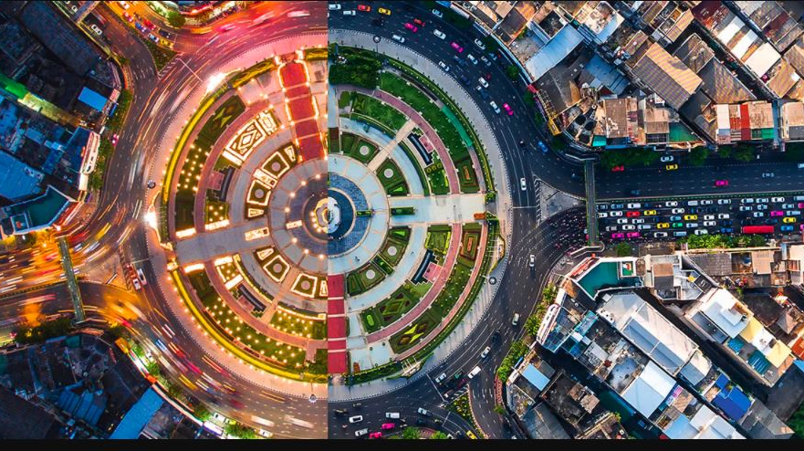
Road Accidents in Seattle
Khushboo Sawlani

Slide 2
Introduction
Seattle City road accidents
Build predictive model to reduce road accidents in Seattle
Success Criteria
Inform traffic about road accidents possibilities.

Slide 3
Data Understanding
Data:
Accident severity – Property Damage and Injury collision
Causes and other factors – Total 37 features available such as Weather, Light Condition, Road condition, Collision Type, etc
Data provided by:
SDOT Traffic Management
Data information
194673 rows × 38 columns
Lot of missing or incorrect data entries

Slide 4
Tools, Language, Libraries used
IBM Cloud Watson Studio – Jupyter Notebook
Python Language
Libraries –
Pandas
Numpy
Matplotlib
Scikit Learn
Scipy
Seaborn
IO
Web browser
Itertools
Random
Folium map

Slide 5
Data Cleaning
Drop unwanted features from the data set.
Find out missing data count for each feature.
Drop rows having values equal to ‘Other’ an ‘Unknown’ from WEATHER, ROADCOND, LIGHTCOND, JUNCTIONTYPE, COLLISIONTYPE features.
Drop value equal to ‘Dark - Unknown Lighting’ in LIGHTCOND as it is unknown.
Replace ‘Y’ by ‘1’ and ‘N’ or ‘nan’(not a number) value by ‘0’ in UNDERINFL, INATTENTIONIND, SPEEDING.
Merge ‘Dark - No Street Lights’ value with ‘Dark - Street Lights Off’ value in LIGHTCOND feature as both values are similar.
Use Randomundersampler resampling technique to balance the SEVERITY CODE

Slide 6
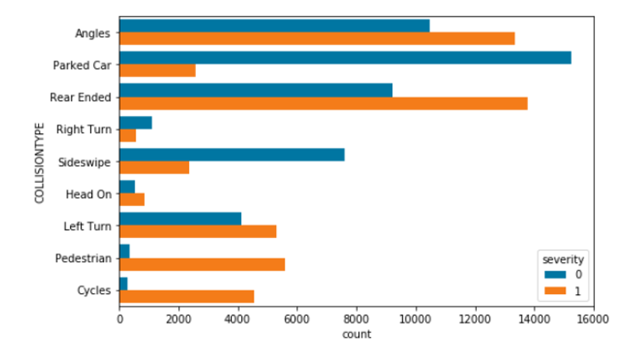
Severity and Collision Type relation
Most property damage – Parked cards
Most injury collisions - Angles, Rear end, Left Turn and by Pedestrian.
Less risk of property damage – Pedestrian, Cycles and Head on.
Less risk of injury collision –Right Turn

Slide 7
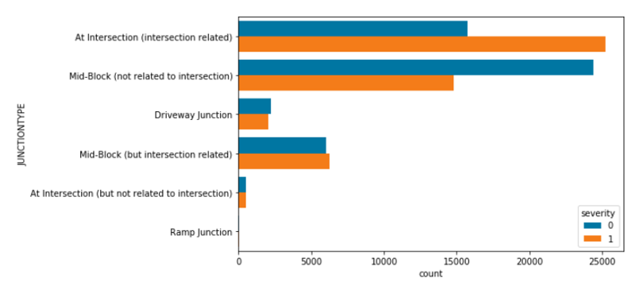
Severity and Junction Type relation
Most injury collisions – At intersection.
Most property damage – Mid Block not related to intersection.

Slide 8
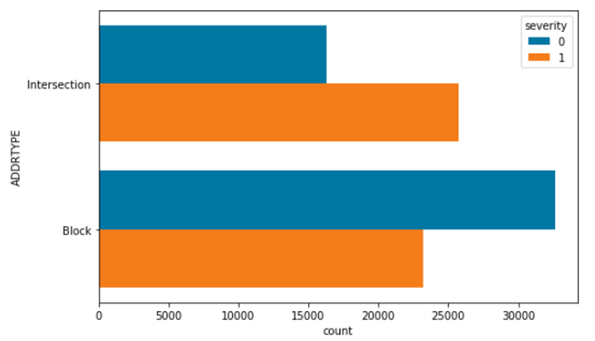
Severity and Address Type relation
Similar results like Junction Type.

Slide 9
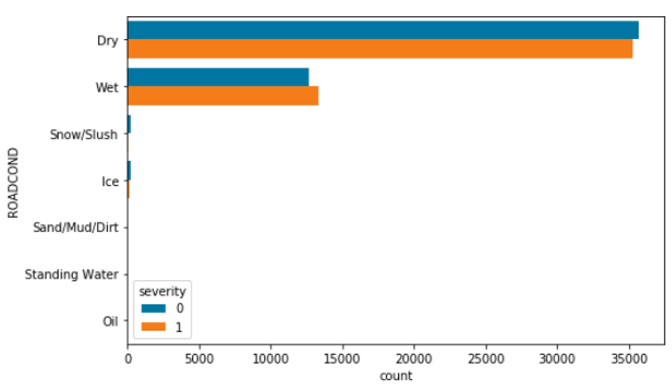
Severity and Road Condition relation
Most Injury collision and Property damage happens in dry roads than wet roads.

Slide 10
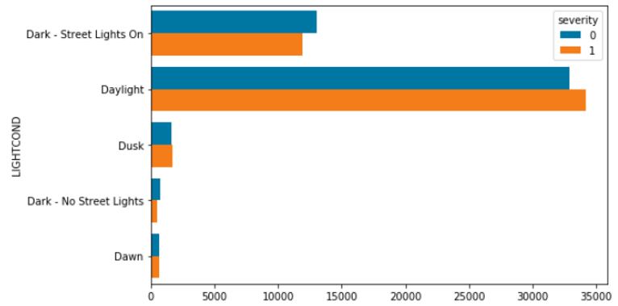
Severity and Light Condition relation
Most Injury collision and Property damage happens during daylight.

Slide 11
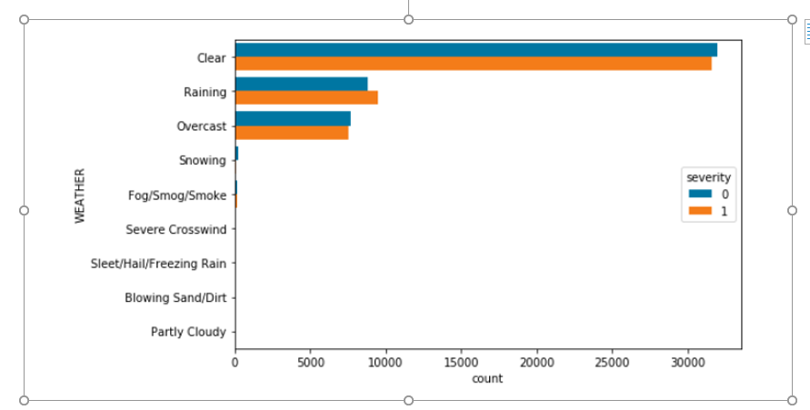
Severity and Weather Condition relation
Most Injury collision and Property damage happens during clear weather.

Slide 12
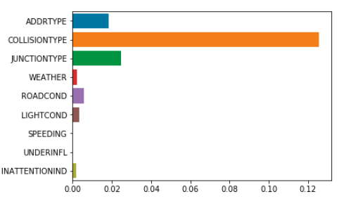
Feature Selection – Mutual information classifier
Based on mutual information classier severity is most affected by collision, junction and address type. However, all these features are known after the collision. Hence, it won’t be selected for modeling.
Weather, Road condition, Light condition and inattention indicator are chosen for predictive modeling.

Slide 13
Classification Algorithm
Below models are selected for data analysis:
KNN -K-Nearest Neighbors
Decision Tree
SVM
Logistic Regression
Random Forest

Slide 14
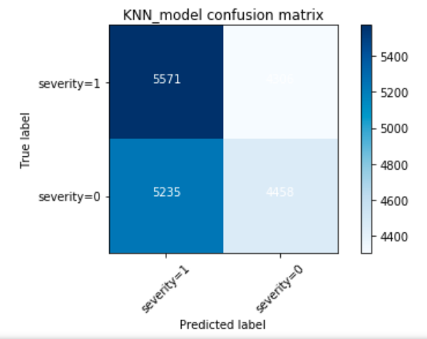
K-Nearest Neighbors
Confusion Matrix
Classification Report
 | Precision | Recall | F1-Score | Support
Property Damage | 0.51 | 0.46 | 0.48 | 9693
Personal Injury | 0.52 | 0.56 | 0.54 | 9877
Accuracy |  |  | 0.51 | 19570
Macro avg | 0.51 | 0.51 | 0.51 | 19570
Weighted avg | 0.51 | 0.51 | 0.51 | 19570
Model Accuracy – 51.28 %

Slide 15
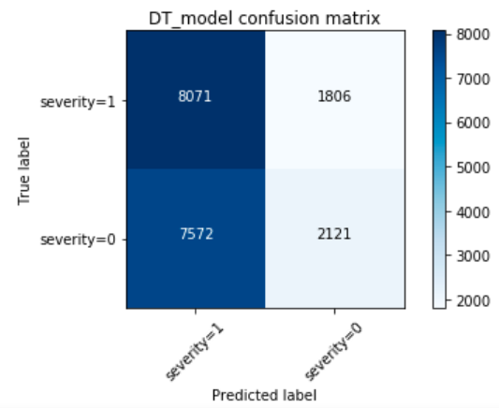
Decision Tree
Confusion Matrix
Classification Report
 | Precision | Recall | F1-Score | Support
Property Damage | 0.54 | 0.22 | 0.31 | 9693
Personal Injury | 0.52 | 0.82 | 0.63 | 9877
Accuracy |  |  | 0.52 | 19570
Macro avg | 0.53 | 0.52 | 0.47 | 19570
Weighted avg | 0.53 | 0.52 | 0.47 | 19570
Model Accuracy – 52.08 %

Slide 16

SVM
Confusion Matrix
Classification Report
 | Precision | Recall | F1-Score | Support
Property Damage | 0.54 | 0.22 | 0.31 | 9693
Personal Injury | 0.52 | 0.81 | 0.63 | 9877
Accuracy |  |  | 0.52 | 19570
Macro avg | 0.53 | 0.52 | 0.47 | 19570
Weighted avg | 0.53 | 0.52 | 0.47 | 19570
Model Accuracy – 52.06 %

Slide 17
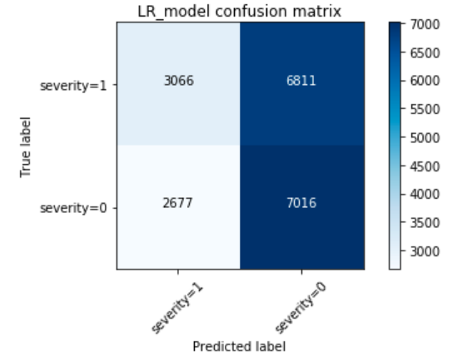
Logistic Regression
Confusion Matrix
Classification Report
 | Precision | Recall | F1-Score | Support
Property Damage | 0.51 | 0.72 | 0.60 | 9693
Personal Injury | 0.53 | 0.31 | 0.39 | 9877
Accuracy |  |  | 0.52 | 19570
Macro avg | 0.52 | 0.52 | 0.49 | 19570
Weighted avg | 0.52 | 0.52 | 0.49 | 19570
Model Accuracy – 51.51 %

Slide 18
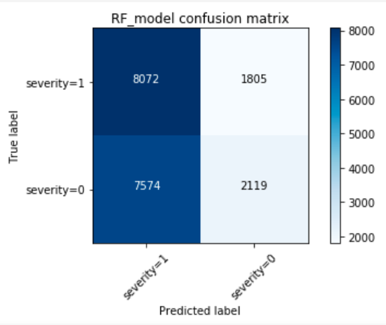
Random Forest
Confusion Matrix
Classification Report
 | Precision | Recall | F1-Score | Support
Property Damage | 0.54 | 0.22 | 0.31 | 9693
Personal Injury | 0.52 | 0.82 | 0.63 | 9877
Accuracy |  |  | 0.52 | 19570
Macro avg | 0.53 | 0.52 | 0.47 | 19570
Weighted avg | 0.53 | 0.52 | 0.47 | 19570
Model Accuracy – 52.51 %

Slide 19
Predictive modeling results
Random forest is the best predictive model to use for car collision data analysis
Model | Accuracy | Jaccard | F1
KNN | 0.51 | 0.37 | 0.51
Decision Tree | 0.52 | 0.46 | 0.47
SVM | 0.52 | 0.46 | 0.47
Logistic Regression | 0.52 | 0.24 | 0.49
Random Forest | 0.52 | 0.46 | 0.47

Slide 20
Conclusion
Data provided was not sufficient for model prediction.
Seattle traffic management should gather more data with severity skewed towards the more serious accidents to find contributing factors involved and alert traffic of accident possibilities.
Observations:
Angles, Rear end and Left turn causes more injury collisions.
Parked cars are more prone towards property damage.
Left turn is riskier than right turn.
Injury occurred more for pedestrian and cyclist than the property damage.
Most of the road accidents happens in clear weather. However, caution should be taken during bad weather condition.
Most of the road accidents happens during day light.

